Slide 1
Team NULL
Ft. Zaid Alsafi, Alex Navarre, Maxx Achtman, Orlando Murrell, Abbass Srour, Brendan Batchelor, and Radhika Moradiya

Slide 2
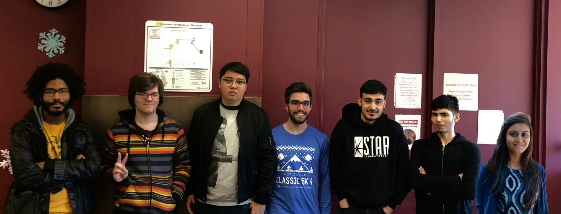
Group Picture

Slide 3
Estimates
Initial Estimate: LoC: 2310 FP: 304 Hours Task: 188 Hours
300 Hours Total
End of Part 1: LoC: 2310 FP: 304 Hours Task: 188 Hours
300 Hours Total
End of Part 2: LoC: 2585 FP: 560 Hours Task: 219 Hours
500 Hours Total
End of Part 3: LoC: 2585 FP: 400 Hours Task: 219 Hours
~400 Hours Total

Slide 4
Estimates
Initial Estimate: LoC: 2585 FP: 304 Hours Task: 188 Hours
300 Hours Total
FINAL: LoC: ~4000 Actual Time: 363 HOURS TOTAL

Slide 5

What was the Easiest
Coding when we had an algorithm (Surprise).
Any tracing we needed to do.
Communication.
(Mostly nothing was easy)

Slide 6

What was the Hardest
Coding when we didn't create any algorithms.
(Everything else was a lot of work but not hard)

Slide 7
What went well and what didn't
What went well…
Testing somewhat?
Documentation
Revising Documents
Communication
What didn't...
Doing any final touches
Coding in a sense
Looking back on our documents to see what we wanted to do at the beginning
Connecting the UI and the simulation system

Slide 8
If we had a time machine what would we change
We would have revised the documents more.
Create ALL ALGORITHMS before we coded.
Looked back on ALL of our documents.
Don't put everything at the end unless we want to have a death march

Slide 9
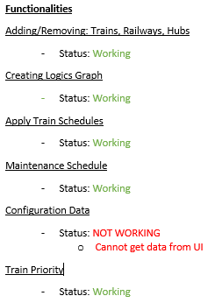
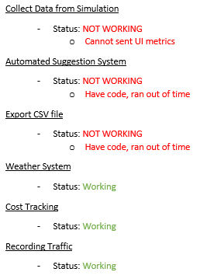

Status of functionality

Slide 10

Project Manager
A lot of mix feelings about this because…
Helpful in certain ways
Knows as much of the program as us
Gave some ideas...
ETC

